Slide 1
Overview
Dr M Shamim Kaiser
kaiser@juniv.edu

Slide 2
Wireless Comes of Age
Guglielmo Marconi invented the wireless telegraph in 1896
Communication by encoding alphanumeric characters in analog signal
Sent telegraphic signals across the Atlantic Ocean Communications satellites launched in 1960s
Advances in wireless technology
Radio, television, mobile telephone, communication satellites
More recently
Satellite communications, wireless networking, cellular technology

Slide 3
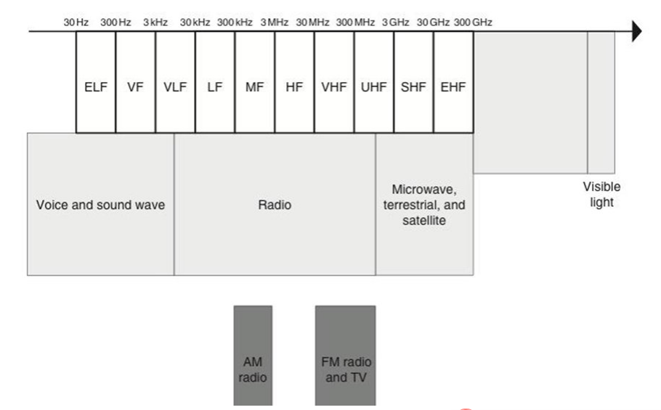
The Electromagnetic Spectrum

Slide 4
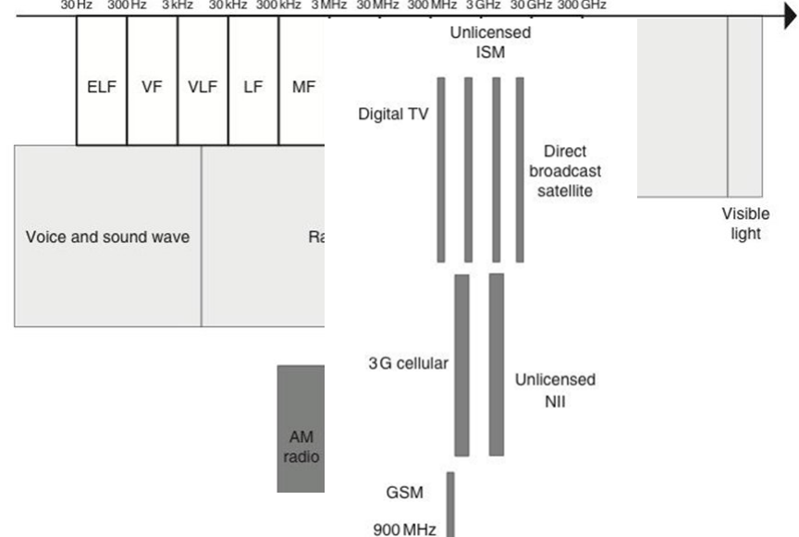
The Electromagnetic Spectrum 2

Slide 5
Different Wireless Technologies
Personal Area Networks: Bluetooth
Local Area Networks: Wifi
Metro and Wide Area Networks: Cellular
Satellite Networks
Sensor networks

Slide 6
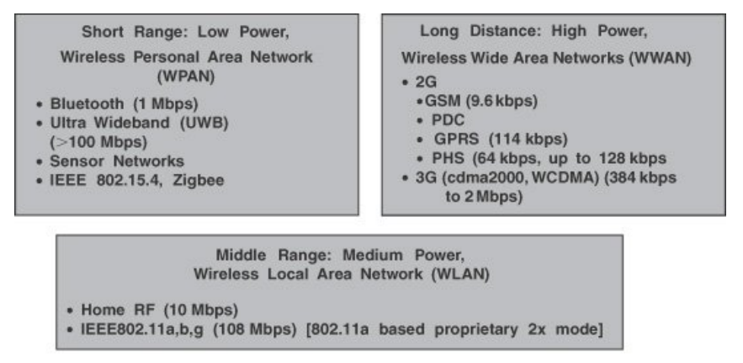
Different Network Characteristic

Slide 7
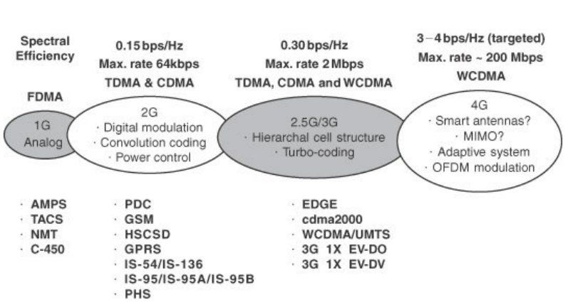
Cellular Network Evolution

Slide 8
Why Wireless?
Ease of use:
Un-tethered use from anywhere
Ease of deployment:
No running media cables between Transceivers
Mobility:
Communicate while moving

Slide 9
Challenges in the Wireless Domain
Inherently broadcast and shared
Users can impact other users, just by co-location or location vicinity
Limited capacity; no adding cables to add capacity
Licensing of spectrum, or ‘collisions’ in unlicensed
Unpredictable Medium
Medium is dynamic, even without devices moving
Devices may be moving
Attenuation with distance, multi-paths, higher error rates, and unpredictable channel responses
Device limitations, such as battery capacity or screen sizes
Politics and Incompatible standards

Slide 10
Electromagnetic Signal
Signal: Electromagnetic (EM) field as a function of time
EM waves may travel in media such as space, air, glass, water etc.
Can equivalently also be expressed as a function of frequency
Signal consists of components of different frequencies

Slide 11
About Channel Capacity
Impairments, such as noise, limit data rate that can be achieved
For digital data, to what extent do impairments limit data rate?
Channel Capacity – the maximum rate at which data can be transmitted over a given communication path, or channel, under given conditions

Slide 12
Concepts Related to Channel Capacity
Data rate - rate at which data can be communicated (bps)
Bandwidth - the bandwidth of the transmitted signal as constrained by the transmitter and the nature of the transmission medium (Hertz)
Noise - average level of noise over the communications path
Error rate - rate at which errors occur
Error = transmit 1 and receive 0; transmit 0 and receive 1

Slide 13
Nyquist Bandwidth
For binary signals (two voltage levels)
C = 2B
With multilevel signaling
C = 2B log2 M
where, M = number of discrete signal or voltage levels

Slide 14
Shannon Capacity Formula
C=Blog₂(1+ SNR)
Represents theoretical maximum that can be achieved
In practice, only much lower rates achieved
– Formula assumes white noise (thermal noise)
– Impulse noise is not accounted for
– Attenuation distortion or delay distortion not accounted for

Slide 15
Example of Nyquist and Shannon Formulations
Spectrum of a channel between 3 MHz and 4 MHz ; SNR(dB) = 24 dB
B=4-3=1MHz
SNR (dB)=24dB=10log₁₀(SNR), thus SNR=251
Using Shannon’s formula
C=8Mbps

Slide 16
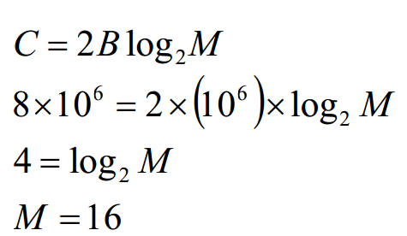
How many signaling levels are required?

Slide 17
Transmission Media
Transmission Medium: Physical path between transmitter and receiver
Guided Media
– Waves are guided along a solid medium
– E.g., copper twisted pair, copper coaxial cable, optical fiber
Unguided Media
– Provides means of transmission but does not guide electromagnetic signals
– Usually referred to as wireless transmission
– E.g., atmosphere, outer space

Slide 18
Unguided Media
Transmission and reception are achieved by means of an antenna
Configurations for wireless transmission
– Directional
– Omnidirectional

Slide 19
General Frequency Ranges
Microwave frequency range
– 1 GHz to 40 GHz
– Directional beams possible
– Suitable for point-to-point transmission
– Used for satellite communications
Radio frequency range
– 30 MHz to 1 GHz
– Suitable for omnidirectional applications
Infrared frequency range
– Roughly, 3x10¹¹ to 2x10¹⁴ Hz
– Useful in local point-to-point multipoint applications within confined areas

Slide 20
Terrestrial Microwave
Description of common microwave antenna
– Parabolic "dish", 3 m in diameter
– Fixed rigidly and focuses a narrow beam
– Achieves line-of-sight transmission to receiving antenna
– Located at substantial heights above ground level
Applications
– Long haul telecommunications service
– Short point-to-point links between buildings

Slide 21
Satellite Microwave
Description of communication satellite
– Microwave relay station
– Used to link two or more ground-based microwave transmitter/receivers
– Receives transmissions on one frequency band
(uplink), amplifies or repeats the signal, and transmits it on another frequency (downlink)
Applications
– Television distribution
– Long-distance telephone transmission
– Private business networks

Slide 22
Broadcast Radio
• Description of broadcast radio antennas
– Omnidirectional
– Antennas not required to be dish-shaped
– Antennas need not be rigidly mounted to a
precise alignment
• Applications
– Broadcast radio
• VHF and part of the UHF band; 30 MHZ to 1GHz
• Covers FM radio and UHF and VHF television

Slide 23
Multiplexing
Capacity of transmission medium usually
exceeds capacity required for transmission
of a single signal
Multiplexing
carrying multiple signals on a single medium
More efficient use of transmission medium

Slide 24
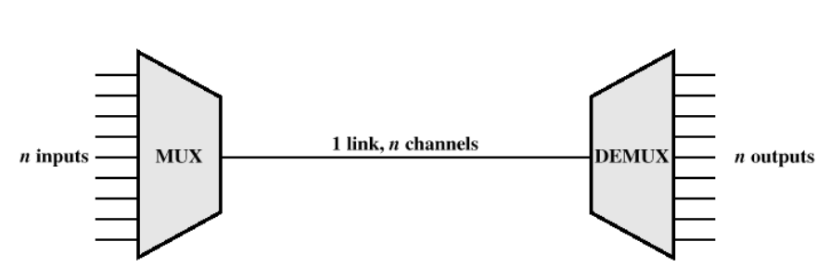

Slide 25
Use of MUX
Cost per kbps of transmission facility declines with an increase in the data rate
• Cost of transmission and receiving equipment declines with increased data rate
• Most individual data communicating devices require relatively modest data rate support

Slide 26
